Slide 1
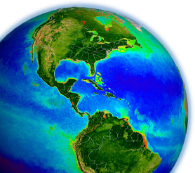
SNPP Ocean SIPS
status
Bryan Franz
and the
Ocean Biology
Processing Group
SNPP Applications Workshop
18 November 2014

Slide 2
VIIRS Ocean Product Status
Currently producing and distributing ocean color products
near real-time and refined (15-45 days later for updated ancillary)
Level-1A & Level-2 (granule), and Level-3 (global) products
MODIS continuity algorithms
Recently updated forward-stream production and completed full mission ocean color reprocessing (R2014.0):
significantly improved instrument calibration
full suite of ocean products consistent with MODIS
new CF-compliant netCDF4 file format for L2 & L3
B. Franz, 17 Nov 2014

Slide 3
Generating Full Set of Ocean Color Products using MODIS Continuity Algorithms
Level-2:
OC suite: Rrs(λ), Chl, Kd(490), PIC, POC, PAR, AOT, Angstrom
IOP suite: a(λ), bb(λ), aph(443), adg(443), bbp(443), uncertainties
VIIRS λ = 410, 443, 486, 551, 671
MODIS λ = 412, 443, 469, 488, 531, 547, 555, 645, 667, 678
total of 31 individual Level-2 products in two files per granule
Level-3:
daily, 8-day, monthly, seasonal, and annual global binned composites
4.6 and 9.2 km mapped products
B. Franz, 17 Nov 2014
Notes:
full set of products proposed by me and others on the VIIRS ST (mostly already implemented in context of PEATE)
biggest limitation for VIIRS is spectral bands

Slide 4
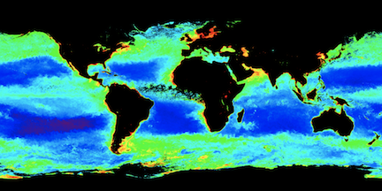
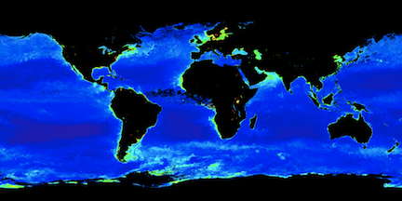
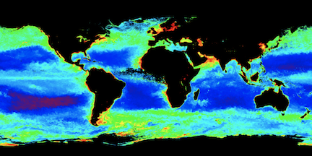
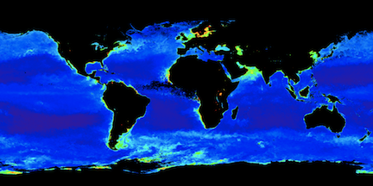
VIIRS & MODISA Winter 2012 NASA/OBPG Calibration & Processing
Chlorophyll
Kd(490) Diffuse Attenuation
VIIRS
VIIRS
VIIRS
MODISA
MODISA
MODISA
B. Franz, 17 Nov 2014

Slide 5
R2014.0 Instrument Calibration
Significantly improved instrument calibration developed for ocean color through the NPP Ocean Science Team (PI Franz, Eplee et al. in prep).
Based on solar calibration, corrected with lunar calibration.
Incorporating significant advancements in solar and lunar calibrator knowledge (solar unit vector fix, lunar libration corrections, etc.).
implemented as a continuous calibration model that allows for extrapolation into the future (improved NRT calibration quality).
Including corrections to the detector relative calibration to reduce image striping artifacts.
B. Franz, 17 Nov 2014
Notes:
lunar-based
exponential model allows forward-stream extrapolation
destriping

Slide 6
Reduced Image Striping
Version R2013.2
Version R2014.0
Revised instrument calibration includes detector relative calibration to reduce image striping artifacts.
B. Franz, 17 Nov 2014

Slide 7
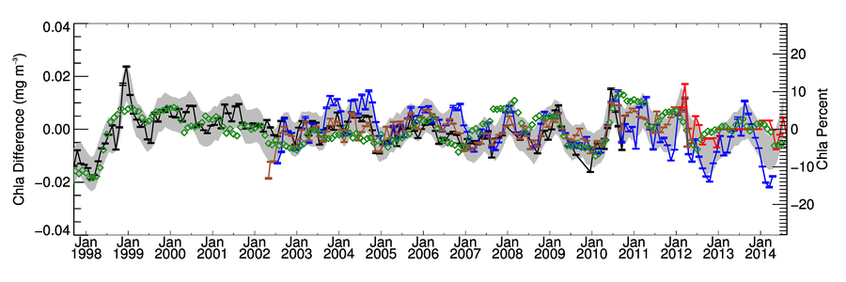
Climate Application: Chlorophyll Anomaly Record
Permanently Stratified
Ocean (PSO)
mean SST > 15C
PSO
PSO Anomaly
Multivariate Enso Index (MEI)
SeaWiFS
MERIS
MODISA
NASA VIIRS
Following Franz, B.A., D.A. Siegel, M.J. Behrenfeld, P.J. Werdell (2013). Global ocean phytoplankton [in State of the Climate in 2012]. Bulletin of the American Meteorological Society, 94(8), S75-S78.

Slide 8
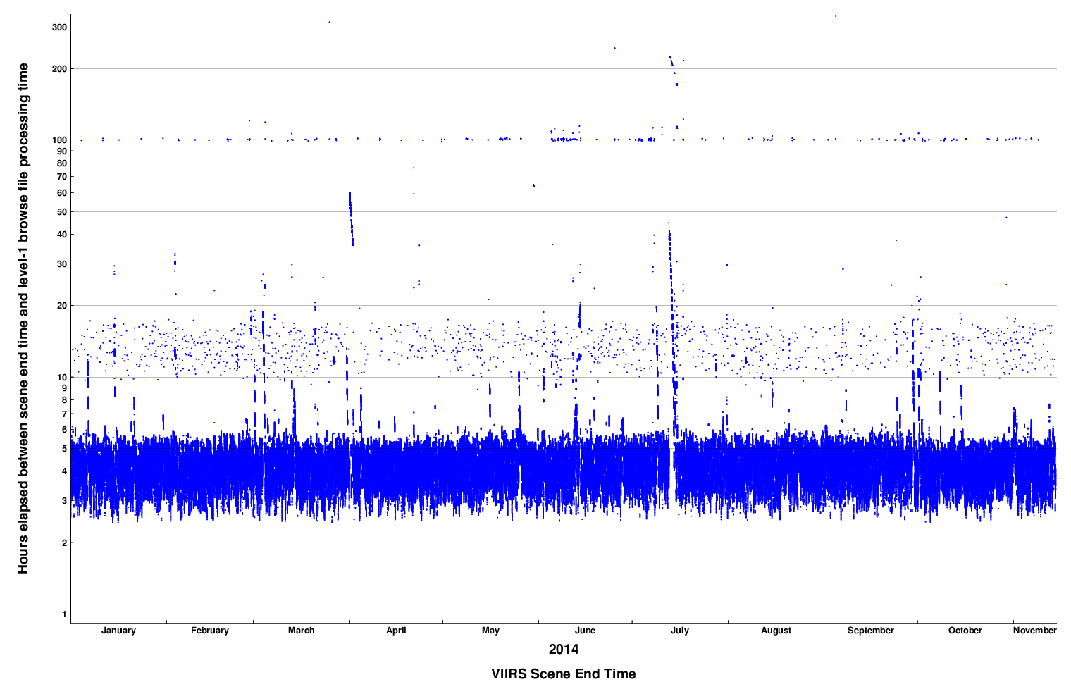
Data Latency
5 hrs
3 hrs
2014
L1 & L2 products typically available within 3-5 hours from time of observation
B. Franz, 17 Nov 2014

Slide 9
Data Access
http://oceancolor.gsfc.nasa.gov/cms/dataaccess
Supporting
Level-1 and Level-2 scene browse for direct access and bulk order
Level-3 browse and direct access
direct access archive (suitable for scripted bulk download)
subscription service
also
coincident field data access
validation match-up analyses (primarily AERONET-OC Rrs validation)
B. Franz, 17 Nov 2014

Slide 10
OBPG Multi-mission Level 1/2 Browser showing VIIRS full mission
B. Franz, 17 Nov 2014

Slide 11
OBPG Level 3 Browser
B. Franz, 17 Nov 2014

Slide 12
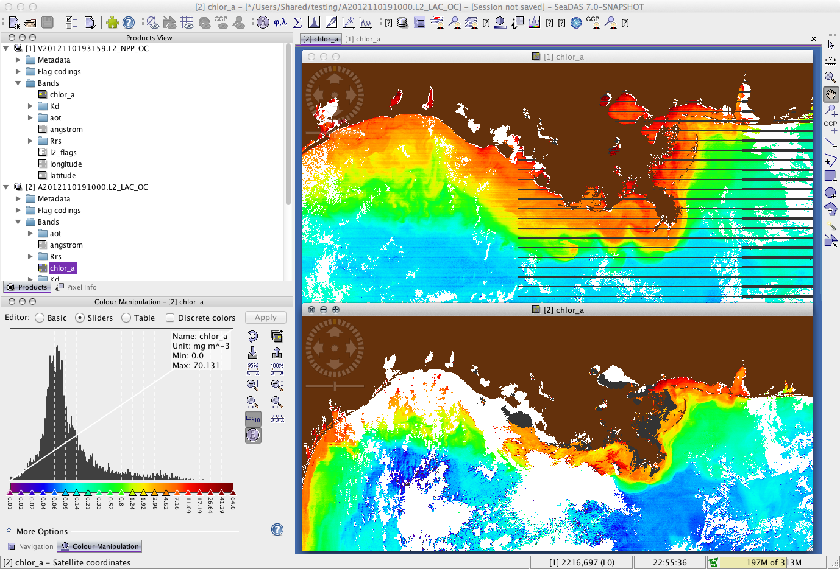
SeaDAS Open Source Software for Application Development
Display & analysis for VIIRS
SDRs
EDRs
NASA L2
NASA L3
Processing capability
Level 1A to Level 2
Level 2 to Level 3
Alternative algorithms
Processing source code
Application development
B. Franz, 17 Nov 2014

Slide 13
Future Plans
Add SST production (Spring 2015)
MODIS heritage algorithm
support for GHRSST
Transition from NOAA RDR and IDPS processing code to NASA Level-0 to Level-1B process and formatting (Spring 2015)
Level-0 via EDOS (may reduce latency further)
Level-1A produced in ~5 minute granule size (no more 86-sec granules!)
Level-1A, Level-1B, and geolocation in compressed netCDF4 format
fully independent instrument calibration approach
B. Franz, 17 Nov 2014

Slide 14
References
data access:
http://oceancolor.gsfc.nasa.gov/cms/dataaccess/
file format:
http://oceancolor.gsfc.nasa.gov/cms/format/l2nc_viirs.html
processing history:
http://oceancolor.gsfc.nasa.gov/cms/reprocessing/
algorithm descriptions:
http://oceancolor.gsfc.nasa.gov/cms/atbd/
B. Franz, 17 Nov 2014

Slide 15
back-up

Slide 16
VIIRS Level-1A to NASA Level-2 and Level-3
ancillary data
sensor-specific tables:
Rayleigh, aerosol, etc.
SeaWiFS L1A
MODISA L1B
MODIST L1B
OCTS L1A
MOS L1B
OSMI L1A
CZCS L1A
MERIS L1B
OCM-1 L1B
OCM-2 L1B
VIIRS L1A
GOCI L1B
L8 OLI L1T
observed
radiances
L2GEN
Level-1 to Level-2
(common algorithms)
in situ water-leaving
radiances (MOBY)
water-leaving
reflectances &
derived prods
predicted
at-sensor
radiances
Level-2 Scene
vicarious calibration
gain factors
Level-3 Global
Product
Level-2 to Level-3

Slide 17
Instrument Temporal Calibration
> 35% sensitivity loss in NIR band M7 (862), but stabilized.

Slide 18
Direct Access Archive

Slide 19
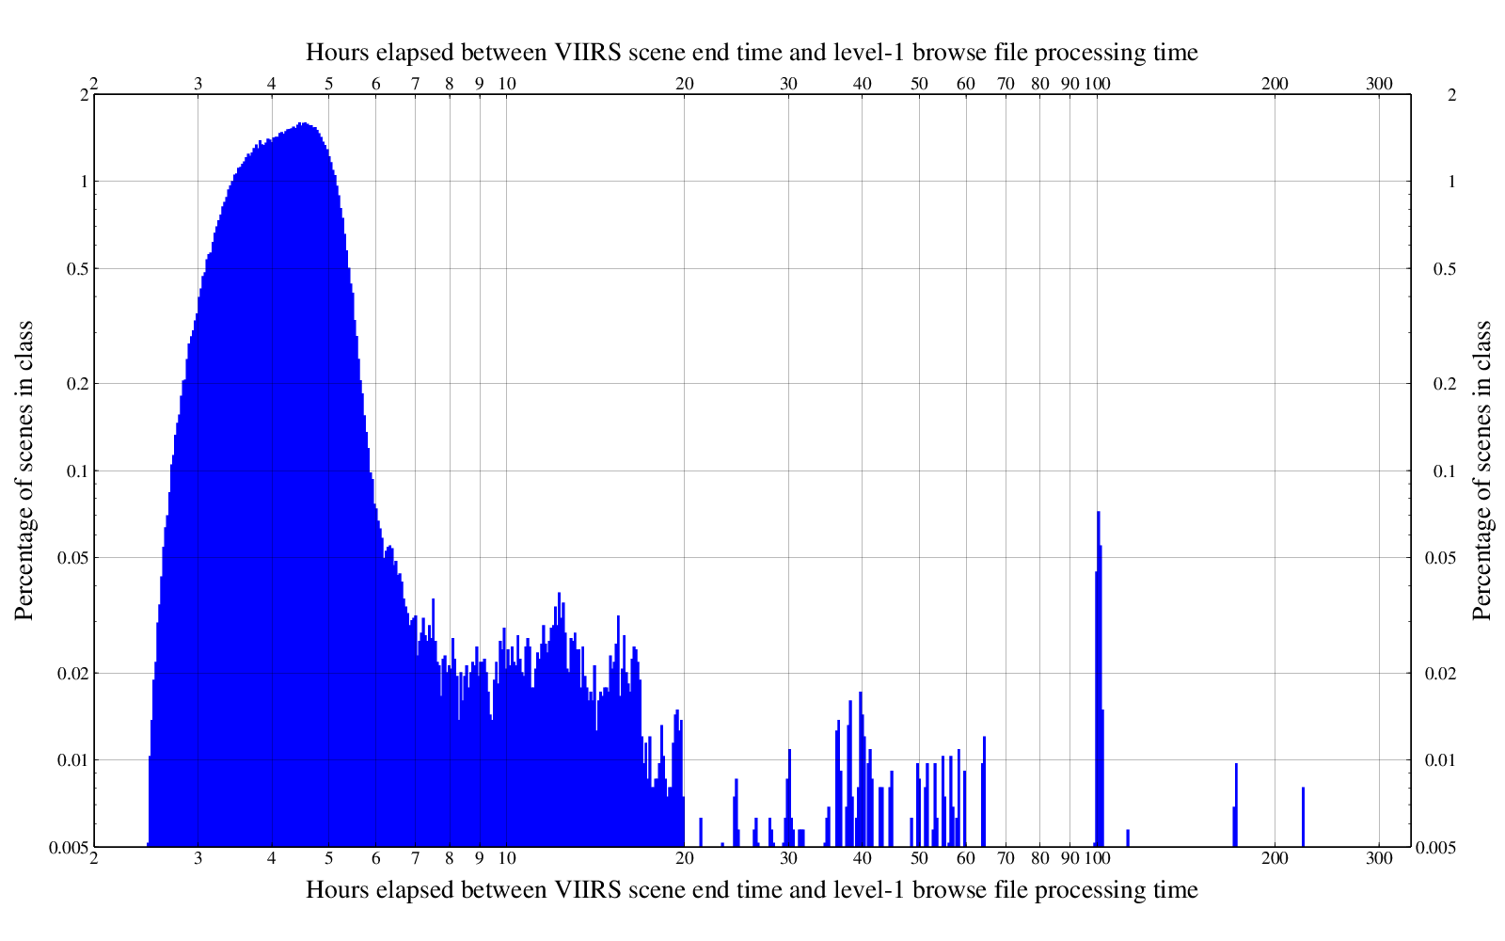
Data Latency
L1 & L2 products typically available within 3-5 hours from time of observation

